Slide 1
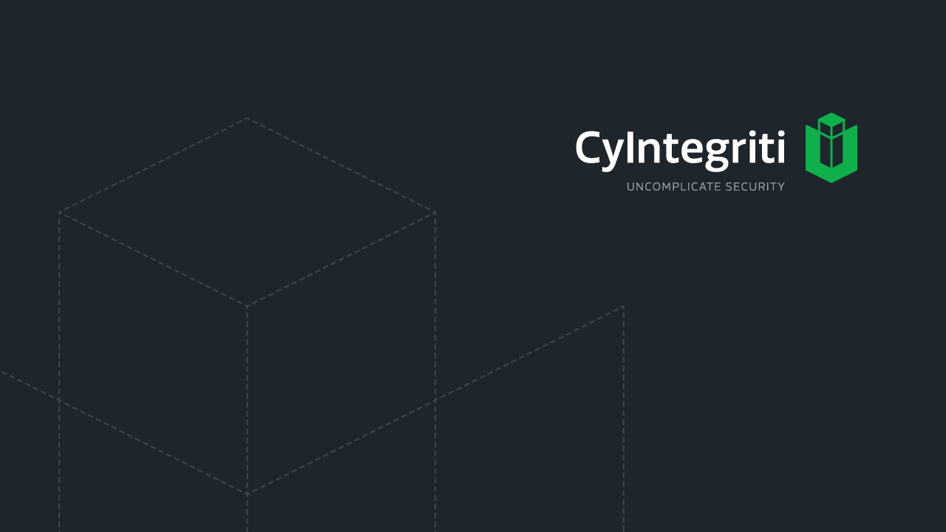
Security Engineering - Cryptography

Slide 2
Concepts
Cryptography is the science of using mathematics to encrypt and decrypt data.
Cryptography enables you to store sensitive information or transmit it across insecure networks (like the Internet) so that it cannot be read by anyone except the intended recipient.

Slide 3
Definitions
Cryptography
Science of secret writing that enables an entity to store and transmit data in a form that is available only to the intended individuals
Cryptosystem
Hardware or software implementation of cryptography that contains all the necessary software, protocols, algorithms, and keys
Cryptology
The study of both cryptography and cryptanalysis
Algorithm (Cipher)
Set of mathematical and logic rules used in cryptographic functions
Kerckhoffs’ principle
Concept that an algorithm should be known and only the keys should be kept secret

Slide 4
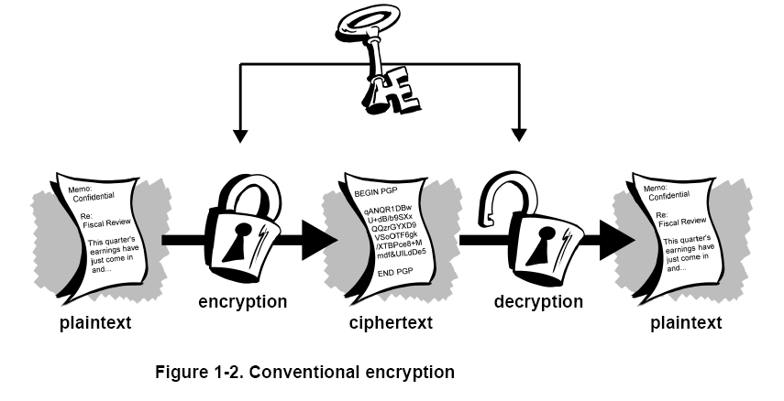
Conventional Encryption

Slide 5
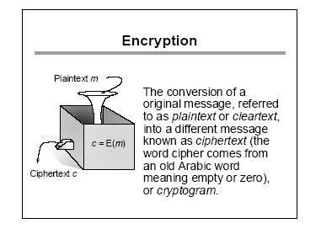

Slide 6
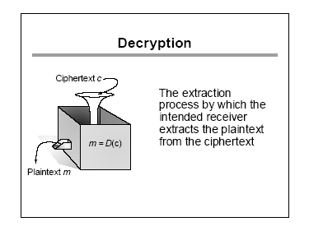

Slide 7
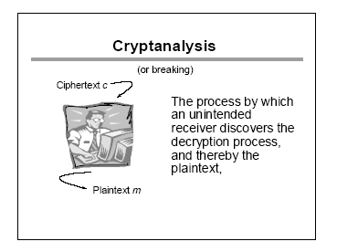

Slide 8
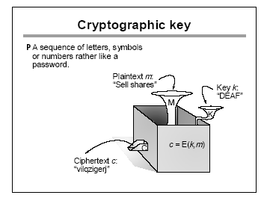
Key
A piece of information that determines the functional output of a cryptographic algorithm.
Key clustering
Instance when two different keys generate the same ciphertext from the same plaintext using the same algorithm
Keyspace
A range of possible values used to construct keys

Slide 9
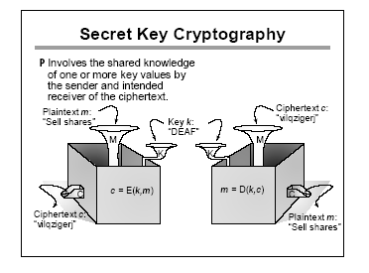

Slide 10
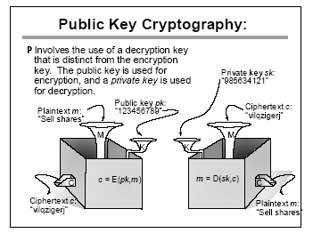

Slide 11
Encryption Schemes
Substitution cipher
is a method of encoding by which units of plaintext are replaced with another plaintext text according to a fixed system; the "units" may be single letters (the most common), pairs of letters, triplets of letters, mixtures of the above, and so forth.
Used in Symmetric algorithms
Provides confusion to cryptanalyst
Monoalphabetic cipher
uses fixed substitution (one character only)
Polyalphabetic cipher
uses a number of substitutions (many alphabets)
Polygraph cipher
a cipher that operates on larger groups of letters

Slide 12
Encryption Scheme
Transposition cipher, simple data encryption scheme in which plaintext characters are shifted in some regular pattern to form cipher text.
Provides diffusion functionality
Scytale is a transposition cipher. A band is wrapped around a rod, a message is written, and when the band is unrolled a ciphertext appears.
Caesar Cipher
Monoalphabetic substitution cipher
Shift cipher
each letter is translated into the letter a fixed number of positions after it in the alphabet table.
the fixed number of positions is a key both for encryption and decryption.

Slide 13
Cryptosystem Strength
The strength of an encryption method depends on
Algorithm
the secrecy of the key
the length of the key
the initialization vectors
How all work together
Work factor
an estimate of the effort and resources it would take an attacker to penetrate a cryptosystem

Slide 14
Cryptosystem Elements
The Important elements of Encryption are
Use an algorithm without flaws
Use a large key size
Use all possible values within the keyspace as randomly as possible
Protect the actual key

Slide 15
Cryptosystem Services
Cryptosystems can provide the following services:
Confidentiality Renders the information unintelligible except by authorized entities.
Integrity Data has not been altered in an unauthorized manner since it was created, transmitted, or stored.
Authentication Verifies the identity of the user or system that created the information.
Authorization Upon proving identity, the individual is then provided with the key or password that will allow access to some resource.
Nonrepudiation Ensures that the sender cannot deny sending the message.

Slide 16
One-Time Pad
Also known as Vernam cipher
Perfect encryption scheme - is considered unbreakable if implemented properly
To use a one-time pad, you need 2 copies of the "pad" ( also known as the key )
Pad
is a block of truly random data at least as long as the message you wish to encode
This encryption process uses a binary mathematic function called exclusive-OR,XOR
Secure Implementation
Made up of truly random values
Used only one time
Securely distributed to its destination
Secured at sender’s and receiver’s sites
At least as long as the message

Slide 17
Steganography
Running Key cipher, uses the components in the real world; eg: the keyword is the text of a predetermined book or passage.
Concealment ciphers include the message within the message
Also called null cipher
Steganography is an example of Concealment cipher
The message is not encrypted but hidden
Security through obscurity concept
Components involved
Carrier – A file or medium that has hidden data inside it
Stegomedium – The medium in which the information is hidden
Payload – The information that is to be concealed and transmitted
Media files are ideal for Steganography
Least significant bit of a file is predominantly used in hiding the message

Slide 18
Encryption Methods
Two Encryption Methods
Symmetric Key Algorithm
Asymmetric Key Algorithm

Slide 19
Symmetric Cryptography
Both the parties share the same key Key [secret key] is used for encryption/decryption Each pair has to have a unique secret key Number of keys = n(n-1)/2 Keys have to be securely shared between communicating parties
Advantage | Disadvantage
Extremely faster than Asymmetric Cryptography Can encrypt/decrypt very large amount of data Hard to break if a large key size is used | Requires a secure out-of-band medium to share the keys As the number of parties increases, manageability of keys is a problem Provides only confidentiality, not authenticity or integrity
Examples DES, 3DES, IDEA, Blowfish, RC4/5/6, AES
SP-Network (Substitution/Permutation)
Used by block ciphers to increase their strength

Slide 20
Asymmetric Cryptography
Pair of keys are required for encryption/decryption These keys are mathematically related Each key is used to encrypt/decrypt Cannot encrypt/decrypt with only one key Public key is usually shared while private key is secured by the owner Secure Message format ~ message is encrypted with receiver's public key ~ Confidentiality Open Message format ~ message is encrypted with sender’s private key ~ Authenticity
Advantage | Disadvantage
Scalable Provides confidentiality, authentication and non-repudiation Better key distribution mechanism | Slower than symmetric key Mathematically complex and intensive task
Examples RSA, ECC, DH, El Gamal, DSA

Slide 21
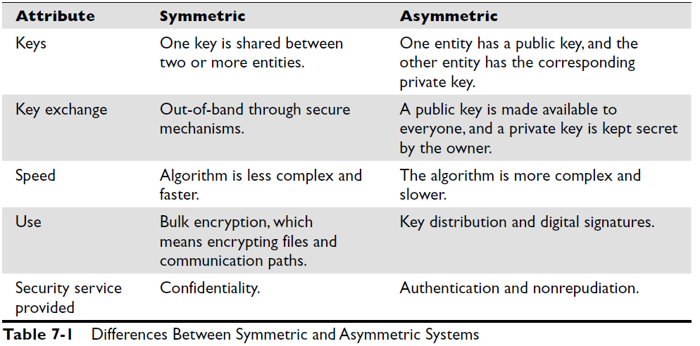
Symmetric vs Asymmetric

Slide 22
Symmetric Algorithm Types
Block ciphers – works on blocks of bits
Stream ciphers – works on one bit at a time

Slide 23
Block Cipher
Plaintext is divided into blocks of data and is encrypted one block at a time
Most block ciphers work with 32, 64 or 128 bit block sizes
Uses both confusion and diffusion to strengthen the encryption process
Confusion is achieved via substitution and diffusion is achieved via transposition
The randomness of the key value and the complexity of the mathematical function determine the confusion and diffusion involved
Confusion pertains to making the relationship between the key and resulting ciphertext as complex as possible so the key cannot be uncovered from the ciphertext.
Diffusion means that a single plaintext bit has influence over several of the ciphertext bits.
Avalanche effect is similar to diffusion ~ if the input to an algorithm is slightly modified then the output of the algorithm is changed significantly.

Slide 24
Stream Cipher
Each plaintext digit is encrypted one at a time with the corresponding digit of the keystream
The encryption of each digit is dependent on the current state ~ called State Cipher
Uses a keystream generator ~ produces a stream of bits that is X-ored with the plain text stream
It is better suited to be implemented at the hardware level
Characteristics of a strong stream cipher
Long periods of no repeating patterns within keystream values
Statistically unpredictable keystream
keystream not linearly related to the key
Statistically unbiased keystream (as many zeroes as ones)
Advantages
Stream ciphers can encrypt and decrypt more quickly
Are able to scale better within increased bandwidth requirements
Used when real-time applications, as in VoIP or multimedia are encrypted
Disadvantages
considered less secure than block ciphers
require a lot of randomness and encrypt individual bits at a time
requires more processing power than block ciphers
generating a truly random and unbiased keystream is difficult

Slide 25
Initialization Vector (IV)
Random values that are used with algorithms to ensure patterns are not created during the encryption process.
They are used with keys and do not need to be encrypted when being sent to the destination
If IVs are not used, then two identical plaintext values that are encrypted with the same key will create the same ciphertext.
The IV and key are both used by the algorithm to provide more randomness to the encryption process

Slide 26
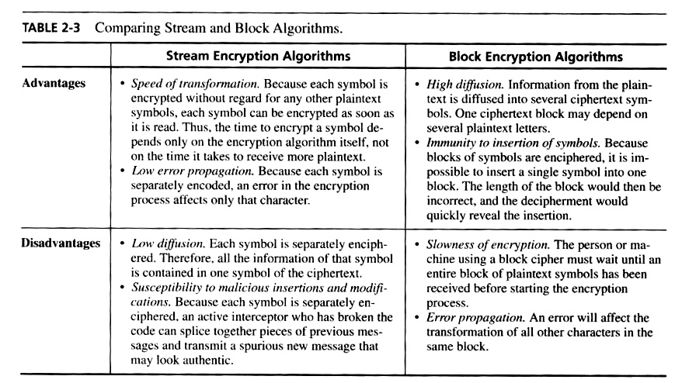
Stream vs Block Symmetric Algorithm

Slide 27
Cryptographic Transformation Techniques
Compression:
Reduce redundancy before plaintext is encrypted
Expansion:
Expanding the plaintext by duplicating values. Commonly used to match the keysize
Padding:
Adding material to plaintext data before it is encrypted
Key mixing:
Using a portion of a key to limit exposure of the key. Keyschedules are used to generate subkeys from master keys.

Slide 28
Hybrid Encryption Methods
Use of Symmetric and Asymmetric Algorithms as complementary methods
Symmetric key is generally used to encrypt the message
Asymmetric key is used to encrypt the Symmetric key
This process is more commonly called as digital envelope

Slide 29
Session Keys
Single use symmetric key that is used to encrypt/decrypt communication between two users for a single session
Its much secure than static symmetric keys
Peers decide on the session key and continue to use it till the session is over
Eavesdropping is difficult, breaking the keys is futile

Slide 30
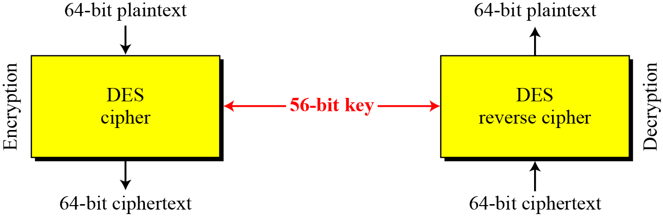
DES
The Data Encryption Standard (DES) is a symmetric-key block cipher
It undergoes 16 rounds of substitution and transposition functions

Slide 31
DES modes
Modes of Operations
Electronic Code Book (ECB)
Cipher Block Chaining (CBC)
Cipher Feedback (CFB)
Output Feedback (OFB)
Counter mode (CTR)

Slide 32
Electronic Code Book (ECB)
Message is broken into independent (64-bit) blocks which are encrypted Each block is encoded independently of the other blocks (No Chaining) Operations can be run in parallel, which decrease processing time Errors are contained Useable only for shorter messages Cannot carry out pre-processing functions before receiving plain text
Advantage | Disadvantage
Faster and Easy | Repetitive information contained in the plaintext may show in the ciphertext, if aligned with blocks. If the same message is encrypted (with the same key) and sent twice, their ciphertext are the same.
Application Secure transmission of short pieces of information (e.g. a temporary encryption key), database, PIN, Challenge-response value

Slide 33
Cipher Block Chaining (CBC)
Solve security deficiencies in ECB
Repeated same plaintext block result in different ciphertext block
Each previous cipher blocks is chained to be input with current plaintext block
The encryption of a block depends on the current and all blocks before it.
So, repeated plaintext blocks are encrypted differently.
Initialization Vector (IV) is used to encrypt the first 64-bit block to bring in randomness
May be sent encrypted in ECB mode before the rest of ciphertext
Uses: bulk data encryption
Notes:
To overcome the problems of repetitions and order independence in ECB, want some way of making the ciphertext dependent on all blocks before it. This is what CBC gives us, by combining the previous ciphertext block with the current message block before encrypting. To start the process, use an Initial Value (IV), which is usually well known (often all 0's), or otherwise is sent, ECB encrypted, just before starting CBC use. CBC mode is applicable whenever large amounts of data need to be sent securely, provided that its available in advance (eg email, FTP, web etc)

Slide 34
Cipher Feedback Mode (CFB)
The block cipher is used as a stream cipher.
enable to encrypt any number of bits e.g. single bits or single characters (bytes)
S=1 : bit stream cipher
S=8 : character stream cipher
A ciphertext segment depends on the current and all preceding plaintext segments.
A corrupted ciphertext segment during transmission will affect the current and next several plaintext segments.
Size of the ciphertext must be the same size as the block of plaintext
Uses: stream data encryption, authentication

Slide 35
Output FeedBack (OFB)
Very similar to CFB
The block cipher is used as a stream cipher.
Appropriate when data arrives in bits/bytes and when error propagation is not accepted
Keystream need to be of the same size as the block of plaintext
Advantage:
more resistant to transmission errors; a bit error in a ciphertext segment affects only the decryption of that segment.
IV should be generated randomly each time and sent with the ciphertext.
Uses: stream encryption over noisy channels (digital video, audio signals)
Notes:
The alternative to CFB is OFB. Here the generation of the "random" bits is independent of the message being encrypted. The advantage is that firstly, they can be computed in advance, good for bursty traffic, and secondly, any bit error only affects a single bit. Thus this is good for noisy links (eg satellite TV transmissions etc).

Slide 36
Counter (CTR)
Uses an IV counter that increments for each plaintext block that needs to be encrypted
Counter for each plaintext will be different
can be any function which produces a sequence which is guaranteed not to repeat for a long time
Strengths:
Needs only the encryption algorithm
Random access to encrypted data blocks
blocks can be processed (encrypted or decrypted) in parallel
Simple; fast encryption/decryption
Counter must be
unknown and unpredictable
Uses: high-speed network encryptions, Encrypting ATM cells, IPSec, Wireless 802.11i

Slide 37
Comparison of Modes
Mode | Description | Application
ECB | 64-bit plaintext block encoded separately | Secure transmission of encryption key
CBC | 64-bit plaintext blocks are XORed with preceding 64-bit ciphertext | Commonly used method. Used for authentication
CFB | s bits are processed at a time and used similar to CBC | Primary stream cipher. Used for authentication
OFB | Similar to CFB except that the output is not fed back | Stream cipher well suited for transmission over noisy channels
CTR | Key calculated using the nonce and the counter value. Counter is incremented for each block | General purpose block oriented transmission. Used for high-speed communications
CCMP | Counter mode with CBC-MAC protocol based on AES encryption using CTR with CBC-MAC | Component of 802.11i wireless standard

Slide 38
Remark on each mode
CBC is an excellent block cipher
CFB, OFB, and CTR are stream ciphers
CTR is faster because simpler and it allows parallel processing
CBC and CFB
reusing an IV leaks some information about the first block of plaintext, and about any common prefix shared by the two messages
OFB and CTR
reusing an IV completely destroys security
Stream ciphers are considered Synchronous cryptosystems
Block Chain ciphers are considered Asynchronous cryptosystems
CTR component in CCMP provides data privacy
In CCMP MAC provides data origin authentication and data integrity for the packet payload

Slide 39
3DES
Uses 48 round computation
Highly resistant to differential cryptanalysis
There is heavy performance hit ~ can take 3 times longer than DES for encryption and decryption
Works in 4 Different modes
DES-EEE3 | Uses 3 different keys for Encryption
DES-EDE3 | Uses 3 different keys, Encrypted, decrypted, encrypted
DES-EEE2 | Uses 2 keys, first and third encryption process uses same key
DES-EDE2 | Uses 2 keys, first and third encryption process uses same key

Slide 40
Rijndael
Block size: 128, 192, 256
Key length: 128, 192, 256
Rounds: variable rounds depending on the key size
Consists of 4 major operations
Substitute Bytes
Shift rows (transposition)
Mix columns

Slide 41
AES
The Advanced Encryption Standard (AES) is a symmetric-key block cipher published by the National Institute of Standards and Technology (NIST) in December 2001
The criteria defined by NIST for selecting AES fall into three areas:
Security
Cost
Implementation
Encrypts and decrypts a data block of 128,192 or 256 bits. It uses 10, 12, or 14 rounds. The number of rounds depends on the key and block size, which can be 128, 192, or 256 bits.

Slide 42
IDEA
IDEA is a block cipher
IDEA operates with 64-bit plaintext and cipher text blocks and is controlled by a 128-bit key
Completely avoid substitution boxes and table lookups used in the block ciphers
The 64-bit plaintext block is partitioned into 16-bit sub-blocks, each has 8 rounds of mathematical functions performed on it.
IDEA is faster than DES when implemented in Software
Used in PGP
It is a patented algorithm

Slide 43
Blowfish
Block cipher: 64-bit block
Variable key length: 32 bits to 448 bits
Data blocks go through 16 rounds of cryptographic functions
Much faster than DES and IDEA
No License required

Slide 44
RC4/RC5/RC6
A series of symmetric encryption algorithms developed by RSA Security
RC4 - a variable key-size stream cipher. The algorithm is based on the use of a random permutation. Simple, fast, efficient
Used in the SSL standards (for secure Web communication), IEEE 802.11 wireless LAN standard, Microsoft Point-to-Point Encryption, and many others
RC5 – Block cipher. Data block sizes:32,64,128 bits; key size goes up to 2048 bits. Number of rounds for encryption/decryption is variable; can go up to 255
RC6 – Block cipher. Same as RC5, increases overall speed from RC5

Slide 45
Skipjack
Operates on 64 bit block of text.
Uses an 89-bit key and 4 modes of operation supported by DES
Provides cryptographic routines supporting clipper and capstone encryption ciphers
It supports escrow of encryption keys
It is approved for use in Federal processing standard (FIPS) 185 and the Escrowed Encryption Standard

Slide 46
Symmetric Keys round up
 | Block Size | Key length | comments
DES | 64bit | 56bit + 8 bit parity | 16 rounds of processing
2DES | 64bit | 112bit | Compromised by Meet-in-the-Middle attack
3DES | 64bit | 168bit
Rijndael | 128,192,256bits | 128,192,256bits | Performs variable rounds of operation
IDEA | 64bit | 128bit | 8 rounds transposition and substitution Used in PGP
CAST | 64bit | 40 to 128bits
SAFER | 64 to 128bit | 64 to 128bit | A version used in Bluetooth
Blowfish | 64bit | Variable key size
Twofish | 128bit | 128, 192, 256 bits
RC5 | 16,32,64bits | 0 to 2040 bits
AES | 128bit | 128, 192, 256 bits

Slide 47
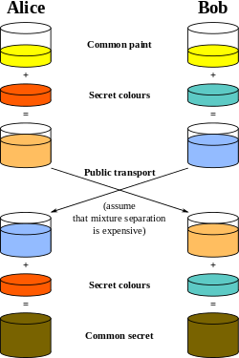
Diffie-Hellman (DH)
Diffie-Hellman is the key distribution asymmetric algorithm
a protocol whereby two or more parties can agree on a key in such a way that both influence the outcome
Allows two users to exchange a secret key
Requires no prior secrets
Does not provide for encryption or digital signature functions
Vulnerable to Man-in-the Middle attack
The algorithm is based on the difficulty of calculating discrete logarithms in a finite field.
Currently used in many protocols, namely:
Secure Sockets Layer (SSL)/Transport Layer Security (TLS)
Secure Shell (SSH)
Internet Protocol Security (IPSec)
Public Key Infrastructure (PKI)

Slide 48
RSA
Most popular Asymmetric Algorithm
De facto standard used for key exchange, encryption, digital signature and authentication
The public and private keys are a function of large prime numbers
It is based on the difficulty of factoring large numbers that are a product of two large prime numbers
Using one-way it provides encryption and signature verification, reverse way it provides decryption and signature generation

Slide 49
El Gamal
El Gamal is a public-key cryptosystem technique based on calculating discrete logarithm problem in a finite field
El Gamal depends on the one way function, means that the encryption and decryption are done in separate functions
Can be used for key exchange, encryption and digital signature
It’s an extension of DH algorithm
El Gamal is the slowest of asymmetric algorithms

Slide 50
Elliptic curve cryptography [ECC]
Elliptic curve cryptography [ECC] is a public-key cryptosystem just like RSA, and El Gamal
The algorithm computes discrete logarithms of elliptic curves
ECC is more efficient than RSA
Provides encryption, digital signature, key exchange
Used in devices with limited processing, storage and bandwidth capacity
Wireless and mobile phone

Slide 51
Kanpsack
These algorithms are based on a mathematical dilemma that poses the following question:
If there are several items each with different weight, is it possible to add these items to a knapsack so the knapsack has a specific weight
The algorithm was discovered to be insecure and is currently not used

Slide 52
Zero Knowledge Proof
Applicable in public-key cryptography
It means someone can tell you something that you can trust without telling you more information that you need
Example, you trust a message based on half the key pair (public key), without needing to know the other half of the pair (private key)

Slide 53
One-way Hash function
A Hash is used to guarantee the integrity of data, a MAC guarantees integrity AND authentication
A Hash take a single input – a message and produces a message digest
A MAC algorithm takes two inputs -- a message and a secret key -- and produces a MAC
Hash can be applied to any size data block
Hash produces fixed-length output
One-way hash function is never used in reverse

Slide 54
Characteristics of Strong Hashing function
Hash should be computed over the entire message
Hash should be a one-way function
Given a message and Hash value, computing another message with the same Hash value should be impossible
Resistant to Birthday attacks

Slide 55
MAC function Types
A function of the message and a secret key that produces a fixed-length value that serves as the authenticator
It is an authentication scheme derived by applying a secret key, in some form, to a message
Receiver performs same computation on message and checks it matches the MAC
Types
Hash MAC (HMAC)
CBC-MAC
CMAC

Slide 56
HMAC
Hash-based Message Authentication Code
Use cryptographic hash function in combination with a secret key
Requires sender and receiver to have the same secret key
Symmetric key is concatenated with the message before it is sent to Hashing algorithm; the output is the MAC value that is appended to the message and sent
The receiver must have the same symmetric key to concatenate and run the Hashing algorithm to obtain the matching MAC value
Message is not encrypted with HMAC, hence no confidentiality provided

Slide 57
Cipher Block Chaining message authentication code (CBC-MAC)
Message is encrypted with symmetric block cipher in CBC mode and the final output is used as MAC
The sender attaches the MAC with the plain text message and sends it
The receiver runs the same symmetric block cipher in CBC mode to generate the same MAC value
It provides data origin authentication (also referred as system authentication) and integrity
Both the parties must have the same keys
MAC authentication is bound to a system and not user; hence provides weak authentication

Slide 58
Cipher-based message authentication code (CMAC)
CMAC is a variation of CBC-MAC
Provides the same type of data origin authentication and integrity
It is more mathematically secure than CBC-MAC
Symmetric algorithm creates a symmetric key
The symmetric key is used to create subkeys
The subkeys are used individually to encrypt the individual blocks of message

Slide 59
Algorithm | Description
MD4 | One-way hash function Produces a 128bit message digest value Used for high speed computations in software implementations Optimized for microprocessors Not used now
MD5 | Produces a 128bit Hash value; Algorithm is more complex Commonly used for file integrity checks used for IDS systems and forensic evidence integrity Susceptible to collision attacks hence no longer used for SSL certificates and digital signatures
SHA | Produces a 160 bit hash value, which is input into an asymmetric algorithm which computes the signature for a message; It is used in Digital signatures It is resistant to brute-force attacks like birthday attacks
HAVAL | Combines variable length output with a variable rounds of operation on 1024bit input blocks Output is 128, 160,192,224, or 256bits in length 60% faster than MD5 when only 3 rounds are used
RIPEMD-160 | 160bit output Operates similar to MD5 on 512bit blocks It does twice the processing of SHA-1, performing 5 paired rounds of 16 steps each for 160 operations
An older algorithm was MD2 – Produced a 128bit message digest value, not in use now

Slide 60
Hash Function Attacks
Collision – An algorithm produces the same value for two different messages
Birthday Attack – Attacker forcing a collision
Hashing algorithms that has larger bit output is less vulnerable to brute-force attacks

Slide 61
Digital Signatures
Combines a hash with a digital signature algorithm
To sign
hash the data
encrypt the hash with the sender's private key
To verify
hash the data
find the sender’s public key
decrypt the signature with the sender's public key
the result of which should match the hash
Hashing provides message integrity, signing of Hash provides authentication and non-repudiation

Slide 62
Digital Signature Standard
NIST approved digital signature algorithms acceptable for FIPS 186-4
DSA specified in FIPS 186-4
RSA specified in ANSI X9.31
ECSA specified in ANSI X9.62
Digital Signature Alogrithm was developed by NSA
It can be used only for digital signature
It is slower than RSA in signature verification

Slide 63
Quantum Cryptography
Uses physics to secure data
Used to generate and distribute secret keys
It is not used to encrypt, transfer or store encrypted data
It solves the key distribution problem allowing the exchange of keys between two remote parties with complete security, using the laws of physics
There are two unique channels within Quantum cryptography
One channel is used for transmission of the quantum key material
Another channel is carries all message traffic
Photons once observed, cannot be eavesdropped without alerting

Slide 64
Public Key Infrastructure (PKI)
ISO Authentication framework that uses Asymmetric algorithm and X.509 standard
Setup to handle authentication across networks
It provides Authentication, Confidentiality, Access control, Integrity and non-repudiation
It helps achieve the following
Identify users / Create and distribute certificates / Maintain and revoke certificates / distribute and maintain encryption keys
PKI is made up of
Certificate Authority(s)
Registration Authority(s)
Certificates
Keys
Users

Slide 65
Certificate Authority (CA)
A trusted third-party responsible for issue and maintenance of Digital Certificates
It can also be internal to an organization
Revocation of certificates is also handled by the CA
The revoked certificates are stored in the Certificate Revocation List (CRL) which is updated and maintained by the CA
Cross certification is a trust relationship established by the CAs whereby they trust the digital certificates provisioned by the trusted CA

Slide 66
Certificate Revocation List (CRL)
Contains the list of all revoked certificates maintained by the CA
Some of the problems with CRL are
Web-browsers do not check a CRL by default
The updates to CRL is not instantaneous, this latency can create threat vector for malicious actions
Online Certificate Status Protocol (OCSP)
It carries out real-time validation of certificate and reports back to the user
It checks the CRL that is maintained by the CA

Slide 67
Certificate
Mechanism used to associate a public key with attributes that will help sufficiently identify the owner
X.509 is the standard that dictates the fields that is used in the certificate and the valid values that can be populated in the fields
A certificate typically includes the following
Serial number / version number / identify information / algorithm information / lifetime date and the signature of the issuing authority

Slide 68
Registration Authority
It performs the certification registration duties
It establishes and confirms the identity of the individual, initates the registration process with CA and performs certificate lifecycle management
RA verifies all the necessary information before allowing a request to go to CA
RA cannot issue certificates

Slide 69
Email Encryption standards
PGP
Combines the CA hierarchy with the “web of trust” concept
One should become trusted by one or more PGP users to begin using the system
Available in two versions
Commercial version:
Uses RSA for key exchange, IDEA for encryption/decryption, MD5 for HASH
Open source version:
Uses DH for key exchange, CAS for encryption/decryption, SHA-1 for HASH
S/MIME
Defacto standard for encrypted email
Uses RSA encryption
Relies on use of X.509 certificates for exchanging keys
Supports AES and 3DES symmetric algorithm

Slide 70
Digital Rights Management – Media protection
Content Scrambling System (CSS)
Enforces playback and region restrictions on DVDs
Was broken with the release of a tool known as DeCSS
Advanced Access Content System (AACS)
Protects the content stored on Blu-Ray and HD DVD media
Major flaw in DRM schemes is that the devices used to access the content must have access to the decryption key

Slide 71
Key Management Rules
Key length should be long enough to provide necessary protection
Keys should stored and transmitted by secure means
Keys should be random and algorithm should use the full keyspace
Key lifetime should correspond to the sensitivity of the encrypted data
The more the key is used, shorter its lifetime
Keys should be backed or escrowed in case of emergency
Keys should be properly destroyed after its lifetime
Key escrow:
An entity with which keys can be stored for recovery at a later point in time

Slide 72
ANSI X9.17
Developed to address the need for financial institutions to transmit securities and fund securely using an electronic medium
It describes a means to ensure the secrecy of the keys
It is based on a hierarchy of keys
At the bottom of the hierarchy are data keys
Used to encrypt and decrypt the messages
They are given shorter lifespan
At the top of the hierarchy are the key-encrypting Master keys (KKMs)\
Used to encrypt the data keys
Must be distributed manually
They are afforded longer lifespans than data keys

Slide 73
Key Escrow
There are two approaches to Key Escrow
Fair Cryptosystem
Secret key is divided into 2 or more pieces, each of which is given to an independent third-party.
Each of these pieces is useless on its own but may be recombined to obtain the secret key
Escrowed Encryption Standard
This provides government with a technological means to decrypt ciphertext
Skipjack algorithm is based on this standard

Slide 74
Trusted Platform Module
Microchip installed on the motherboard that is dedicated to carrying out security functions on the system
Two major functions of TPM are
Binding the hard disk drive
Content of the Hard disk drive is encrypted and the decryption key is stored away in the TPM chip
If the TPM chip fails the encrypted content in the HDD will be rendered useless
Sealing a system configuration
TPM generates hash values based on the systems configuration and stores them in TPM chips
Only after TPM verifies the integrity of the system’s configuration will it allow activation of the system

Slide 75
Trusted Platform Module - Memory
TPMs internal storage is based on NVRAM
Internal memory is divided into two segments
Persistent (Static) memory
Versatile (dynamic) memory
Two kinds of keys are present in the static memory
Endorsement Key (EK)
Public/private key pair installed during manufacture that cannot be altered
It is unique to the TPM and its platform
Private Key is always present inside the chips, while public key is used to verify the authenticity of the TPM itself
Storage Root Key (SRK)
Master wrapping key used to secure the EK stored in the system

Slide 76
Trusted Platform Module - Memory
Three kinds of keys are present in dynamic memory
Attestation Identity Key (AIK)
Used for the attestation of the TPM chip to the service providers
AIK is linked to the TPM’s EK and helps ensure integrity of the EK
Platform Configuration Register (PCR)
Used to store crypto hashes of data used for TPMs sealing function
Storage Keys
Used to encrypt the storage media of the computer system

Slide 77
Attacks on Cryptography
There are two kinds of attacks
Passive attacks
Attacks that do not need active intrusion of the algorithms;
They are used to gain information before launching active attacks
It is difficult to detect
Controls can be placed to prevent them rather than detect and stop
Active attacks
Attacks that involved active intrusion of the message
Involves altering messages, modifying system files, masquerading as another individual
Common attack vectors are
Key, algorithm, implementation, data, and users

Slide 78
Attacks on Cryptography
Ciphertext-only Attacks | Attacker has the ciphertext of several messages encrypted using the same algorithm Goal is to identify the key used Most common active attack but the hardest to be successful
Known-plaintext attacks | Attacker has access to both the plain-text and cipher-text Goal is to identify the key used Was used by US against Germany and Kapan during WWII
Chosen-plaintext attacks | Attacker has access to both the plain-text and cipher-text He may also have access to the algorithm or the system used to do encryption Goal is to determine the key Attacker can choose plain-text to be encrypted and checks for patterns It helps known-plain text attacks
Chosen-ciphertext attacks | Attacker has access to both the plain-text and cipher-text He also has access to the algorithm or the system used to do decryption Attacker can choose cipher-text to be decrypted and checks for patterns RSA is vulnerable to this attack This attack is considered to best possible attack

Slide 79
Attacks on Cryptography
Differential Cryptanalysis | Also called side-channel attack Measures the exact execution times and power required by crypto device to perform encryption/decryption function Its an effective and successful attack against DES It is considered a type of chosen-plain text attack It’s a more complex attack
Linear Cryptanalysis | Attacker carries out known-plaintext attack on several different messages encrypted with the same key It is used to identify the highest probability of a specific key employed during the encryption process using block algorithm cipher
Side-channel attacks | It is considered a passive implementation attack it relies on physical attributes of the implementation such as power consumption/emanation
Fault Analysis attack | It is considered an active implementation attack Attempts to force the system into an error state to gain erroneous results Comparing with good results, an attacker may learn about the key and the algorithm
Probing Attack | It is considered an active implementation attack Attacker watches the circuitry surrounding the crypto module in the hose that the complementary components will disclose information about the key or the algorithm

Slide 80
Replay Attack | Attacker captures the authentication data between distributed systems and resubmits it with the hopes of fooling the receiving device into thinking it is legitimate Countermeasures are Time-stamping and sequence numbers
Algebraic Attack | Analyses the vulnerabilities in the mathematics used within the algorithm and exploit the intrinsic algebraic structure.
Analytic Attack | Takes advantage of the algorithm’s structural weakness or flaws Double DES attack and RSA factoring attack are examples of this attack
Statistical Attack | Takes advantage of the statistical weakness in algorithm design
Birthday Attack | It is easier to find two messages that hash to the same hash value than to match a specific hash with another Use the hash algorithm that is twice the length of the message digest as the desired work factor to prevent this attack
Meet-in-the-middle | Uses a known-plaintext attack The plaintext is encrypted using all possible keys and the resulting ciphertext is decrypted using all possible keys; the matching pairs will provide the key Double DES was successfully attacked via this method
Brute force Attack | Most common attack, all possible keys are tried until one is found to decrypt the ciphertext Rainbow table is used to speed-up the process It is a lookup table for stored hash values

Slide 81

Karthikeyan Dhayalan
MD & Chief Security Partner
www.cyintegriti.com

